Slide 1
Build Applications Faster with Android Jetpack
Gilang Ramadhan,
Academy Content Writer at Dicoding

Slide 2
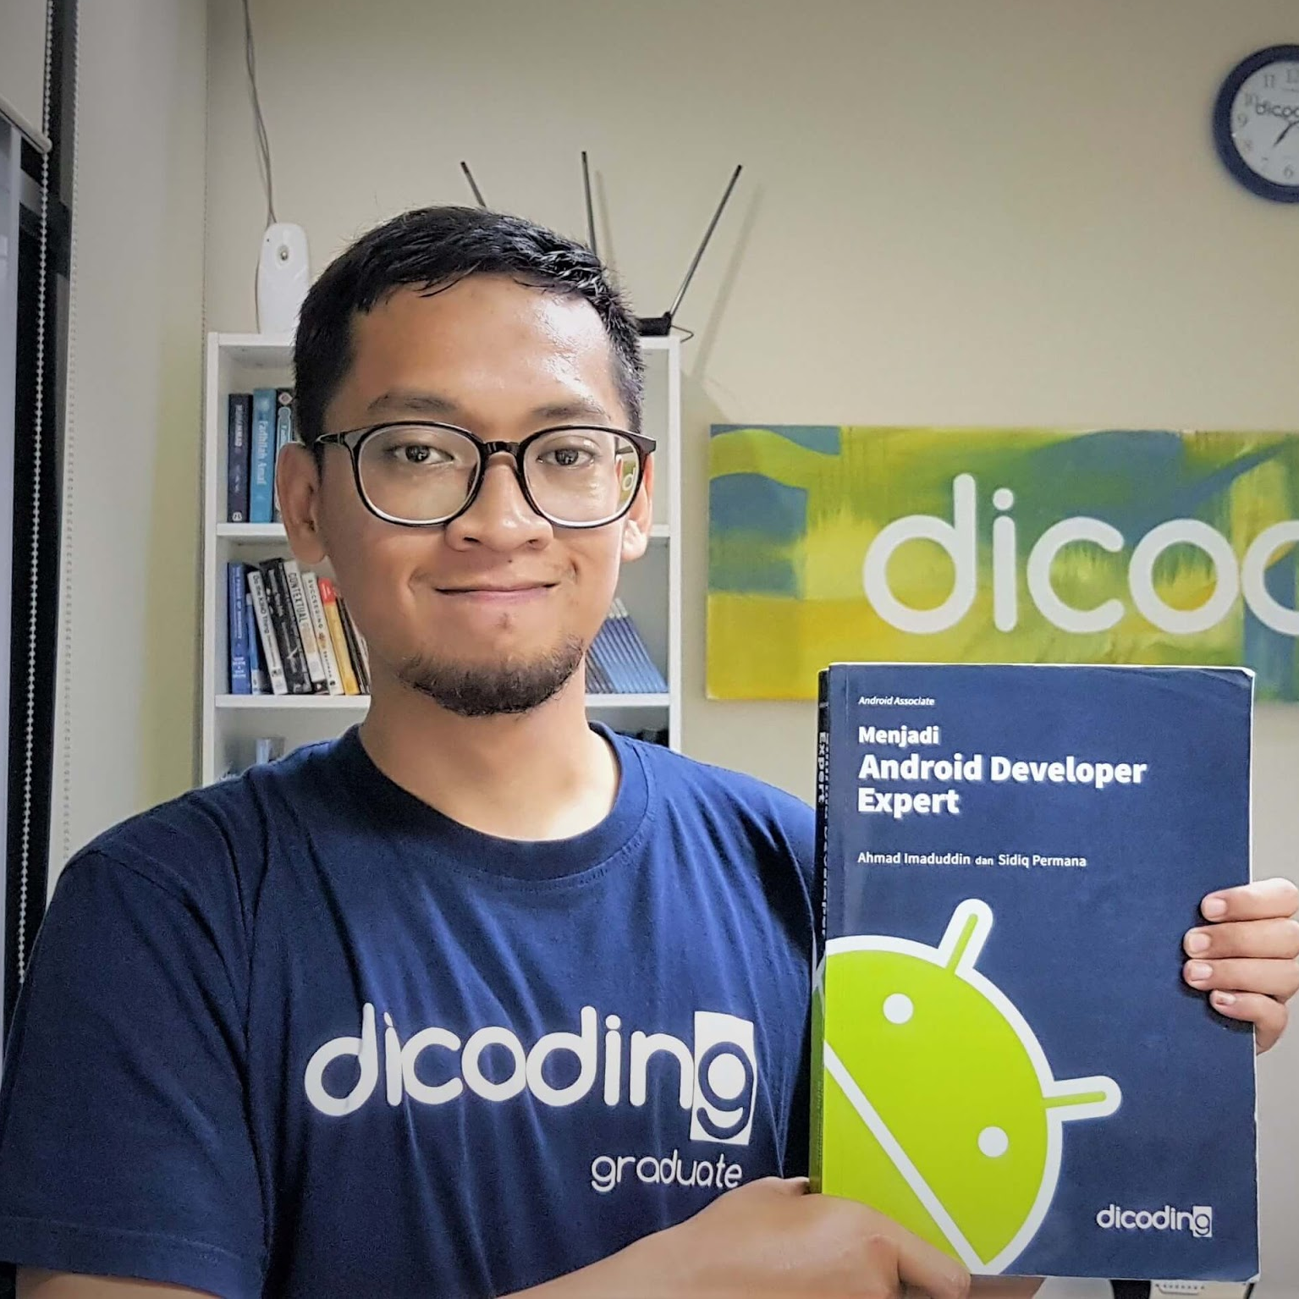
Gilang Ramadhan
Academy Content Writer at Dicoding
(Associate Android Developer)

Slide 3

What is Android Jetpack?

Slide 4

Jetpack?
Kiri, Kanan, L1, L2, R1, R2, Atas, Bawah, Kiri, Kanan

Slide 5


Android Jetpack
Jetpack is a collection of Android software components to make it easier for you to develop great Android apps.
Notes:
Jetpack is a collection of Android software components to make it easier for you to develop great Android apps. These components help you follow best practices, free you from writing boilerplate code, and simplify complex tasks, so you can focus on the code you care about.
Jetpack comprises the androidx.* package libraries, unbundled from the platform APIs. This means that it offers backward compatibility and is updated more frequently than the Android platform, making sure you always have access to the latest and greatest versions of the Jetpack components.

Slide 6

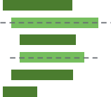

Advantages
Accelerate development
Eliminate boilerplate code
Build high quality, robust apps
Notes:
Components are individually adoptable but built to work together while taking advantage of Kotlin language features that make you more productive.
Android Jetpack manages tedious activities like background tasks, navigation, and lifecycle management, so you can focus on what makes your app great.
Built around modern design practices, Android Jetpack components enable fewer crashes and less memory leaked with backwards-compatibility baked in.

Slide 7




Android Jetpack Components
Foundation
Architecture
Behavior
UI
Notes:
Foundation components provide cross-cutting functionality like backwards compatibility, testing and Kotlin language support.
Architecture components help you design robust, testable and maintainable apps.
Behavior components help your app integrate with standard Android services like notifications, permissions, sharing and the Assistant.
UI components provide widgets and helpers to make your app not only easy, but delightful to use.

Slide 8
Android Jetpack Components
Foundation
Notes:
Foundation components provide cross-cutting functionality like backwards compatibility, testing and Kotlin language support.
Architecture components help you design robust, testable and maintainable apps.
Behavior components help your app integrate with standard Android services like notifications, permissions, sharing and the Assistant.
UI components provide widgets and helpers to make your app not only easy, but delightful to use.

Slide 9
Foundation - AppCompat
Degrade gracefully on older versions of Android
Before After
com.android.support:cardview-v7 androidx.cardview:cardview:1.0.0
com.android.support:appcompat-v7 androidx.appcompat:appcompat:1.0.0
com.android.support:recyclerview-v7 androidx.recyclerview:recyclerview:1.0.0
android.arch.persistence.room:common androidx.room:room-common:2.0.0-rc01
android.arch.core:common androidx.arch.core:core-common:2.0.0-rc01
android.arch.core:core androidx.arch.core:core:2.0.0-rc01
android.arch.paging:common androidx.paging:paging-common:2.0.0-rc01
.... ....

Slide 10

Foundation - Android KTX
Write more concise, idiomatic Kotlin code
Getting Started
dependencies {
implementation 'androidx.core:core-ktx:1.0.0'
}
Before
sharedPreferences.edit()
.putBoolean("key", value)
.apply()
After
sharedPreferences.edit {
putBoolean("key", value)
}

Slide 11
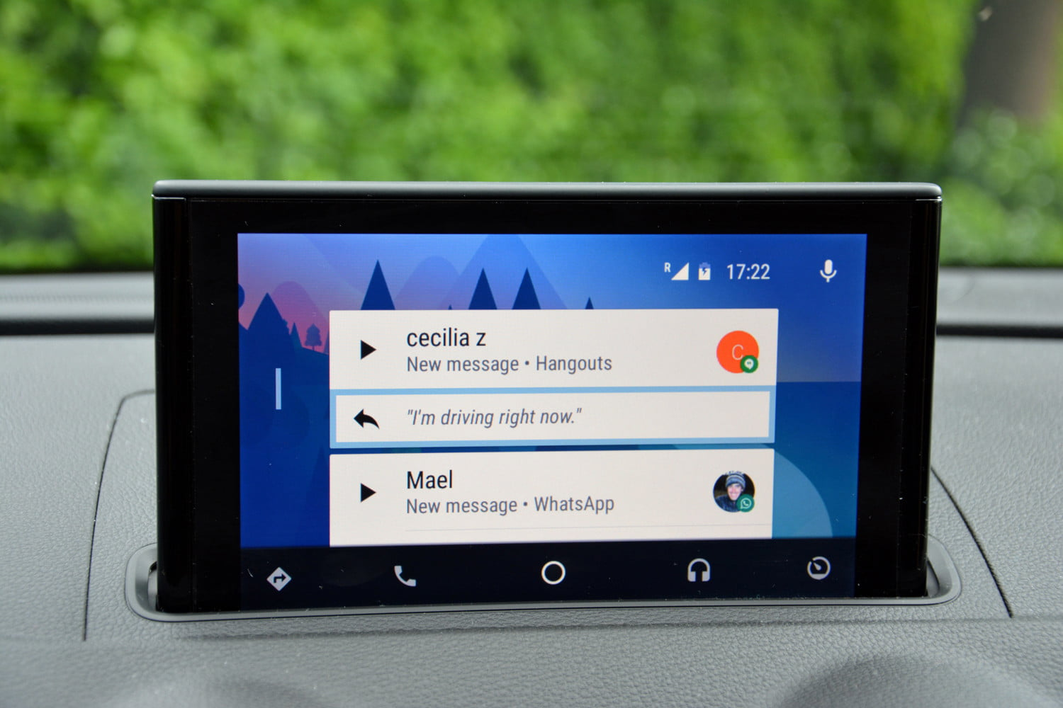

Foundation - Auto
Components to help develop apps for Android Auto

Slide 12
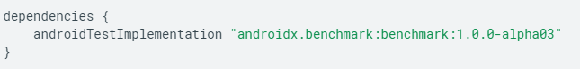
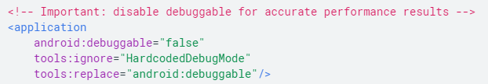
Foundation - Benchmark
Quickly benchmark your Kotlin-based or Java-based code from within Android Studio
Add the library to your module’s build.gradle file:
project_root/module_dir/build.gradle
To disable debugging in the test manifest, update your <application> element to force-disable debugging temporarily as follows:
project_root/module_dir/src/androidTest/AndroidManifest.xml

Slide 13
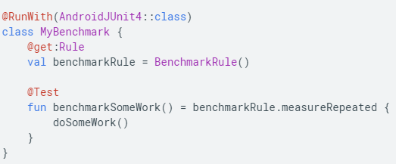
Foundation - Benchmark
Quickly benchmark your Kotlin-based or Java-based code from within Android Studio
To add your benchmark, add an instance of BenchmarkRule in a test file in the androidTest directory. For more information on writing benchmarks, see Write a benchmark.
The following code snippet shows how to add a benchmark to a JUnit test:

Slide 14

Foundation - Multidex
Provide support for apps with multiple DEX files
Enable multidex for apps with over 64K methods
Multidex Support prior to Android 5.0 (Api 21)
android {
defaultConfig {
...
minSdkVersion 15
targetSdkVersion 28
multiDexEnabled true
}
...
}
dependencies {
compile 'com.android.support:multidex:1.0.3'
}

Slide 15
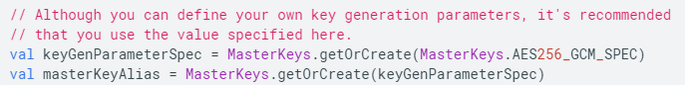
Foundation - Security
Read and write encrypted files and shared preferences by following security best practices.
Strong security that balances great encryption and good performance.
Maximum security.
The Security library uses a 2-part system for key management:
A keyset that contains one or more keys to encrypt a file or shared preferences data. The keyset itself is stored inSharedPreferences.
A master key that encrypts all keysets. This key is stored using the Android keystore system.

Slide 16
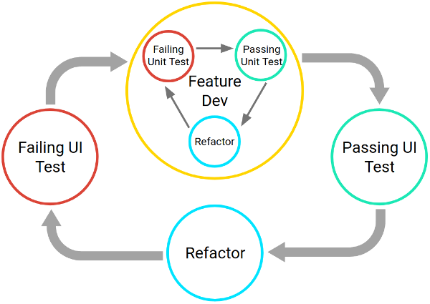
Foundation - Test
An Android testing framework for unit and runtime UI tests
Notes:
Testing also provides you with the following advantages:
Rapid feedback on failures.
Early failure detection in the development cycle.
Safer code refactoring, letting you optimize code without worrying about regressions.
Stable development velocity, helping you minimize technical debt.

Slide 17
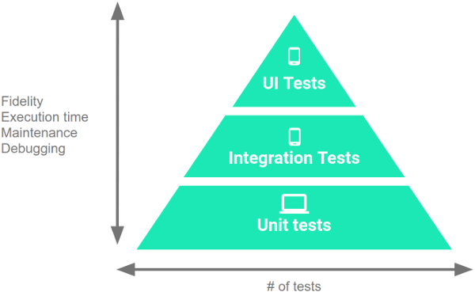
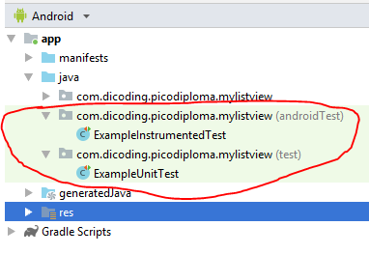
Foundation - Test
An Android testing framework for unit and runtime UI tests

Slide 18
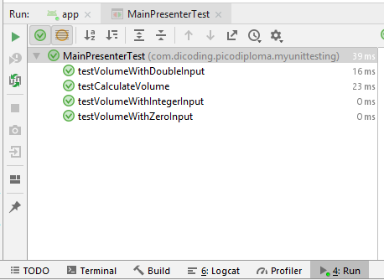
Foundation - Unit Test
Getting Started
dependencies {
// Required -- JUnit 4 framework
testImplementation 'junit:junit:4.12'
// Optional -- Robolectric environment
testImplementation 'androidx.test:core:1.0.0'
// Optional -- Mockito framework
testImplementation 'org.mockito:mockito-core:1.10.19'
}

Slide 19
Foundation - Instrumental Testing
Getting Started
dependencies {
androidTestImplementation 'androidx.test:runner:1.1.0'
androidTestImplementation 'androidx.test:rules:1.1.0'
// Optional -- Hamcrest library
androidTestImplementation 'org.hamcrest:hamcrest-library:1.3'
// Optional -- UI testing with Espresso
androidTestImplementation 'androidx.test.espresso:espresso-core:3.1.0'
// Optional -- UI testing with UI Automator
androidTestImplementation 'androidx.test.uiautomator:uiautomator:2.2.0'
}

Slide 20
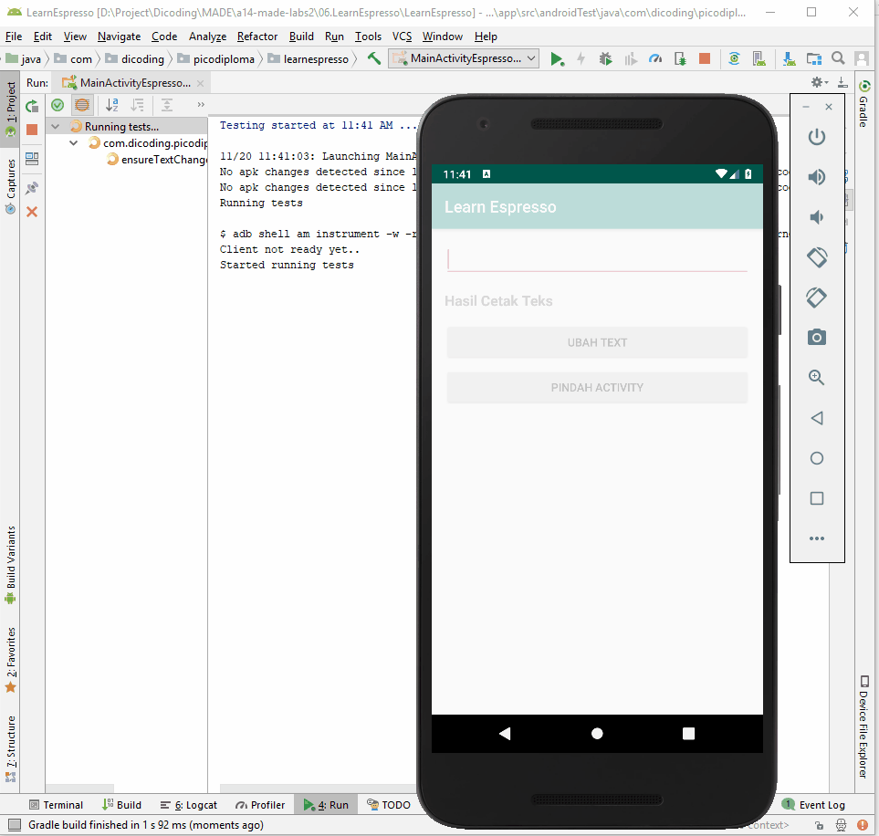


Slide 21

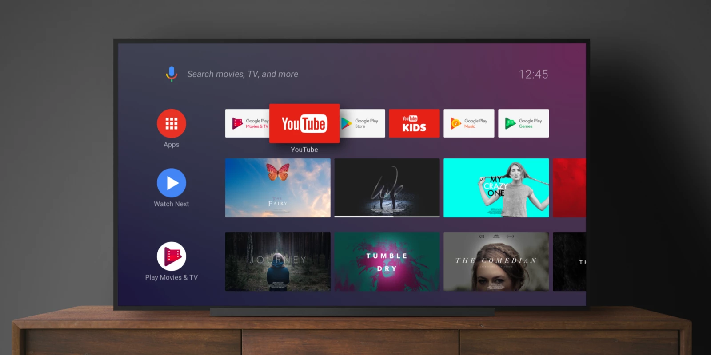
UI - TV
Components to help develop apps for Android TV

Slide 22

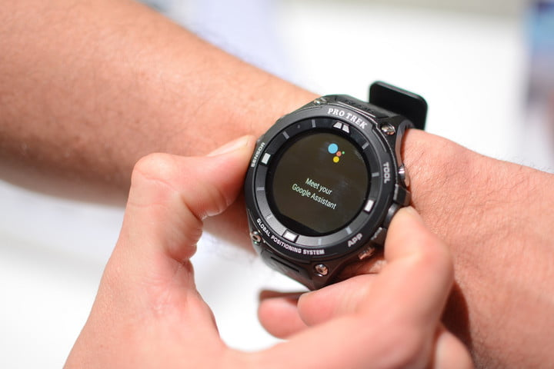
UI - Wear OS by Google
Components to help develop apps for Wear

Slide 23
Android Jetpack Components
Architecture
Notes:
Foundation components provide cross-cutting functionality like backwards compatibility, testing and Kotlin language support.
Architecture components help you design robust, testable and maintainable apps.
Behavior components help your app integrate with standard Android services like notifications, permissions, sharing and the Assistant.
UI components provide widgets and helpers to make your app not only easy, but delightful to use.

Slide 24
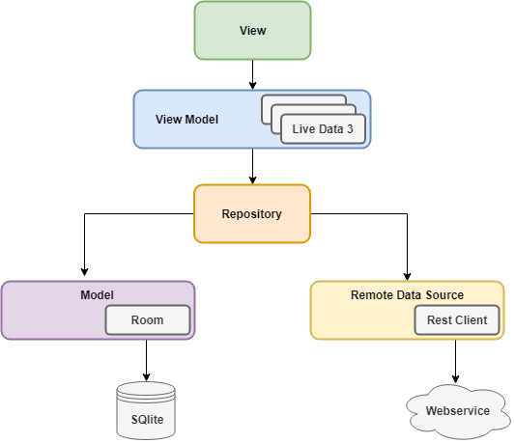

Architecture Component

Slide 25
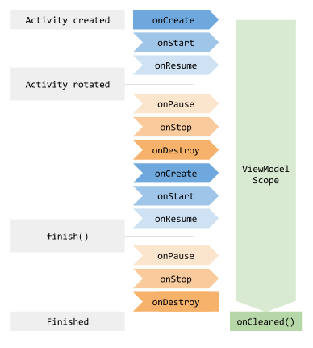
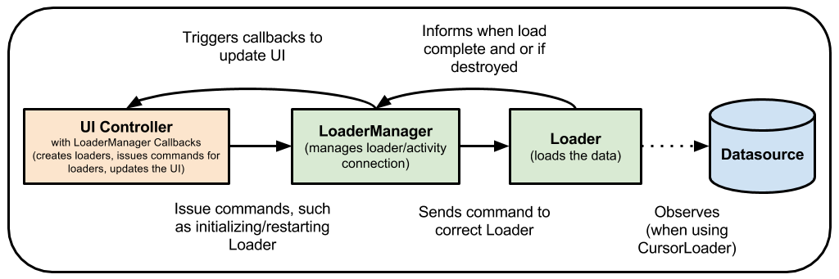
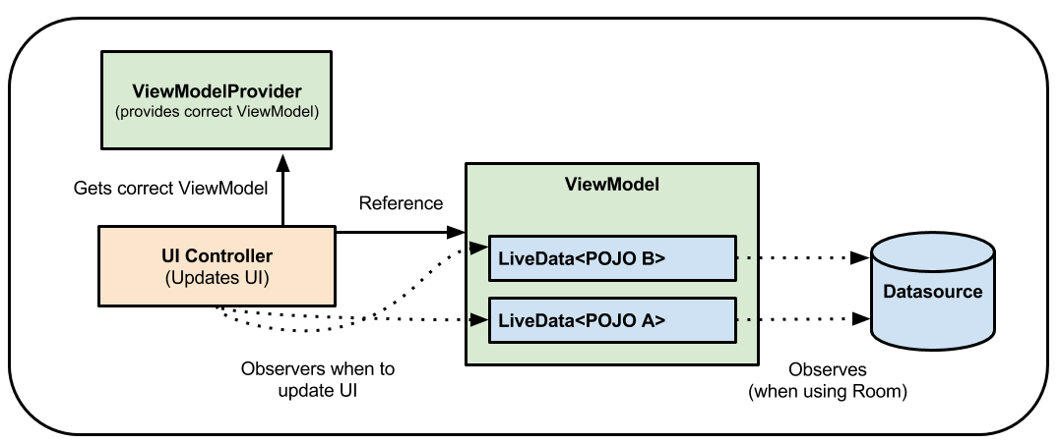
Architecture - ViewModel
Manage UI-related data in a lifecycle-conscious way

Slide 26

Architecture - LiveData
Notify views when underlying database changes
Ensures your UI matches your data state
No memory leaks
No crashes due to stopped activities
No more manual lifecycle handling
Always up to date data
Proper configuration changes
Sharing resources

Slide 27
Architecture - LiveData
Notify views when underlying database changes
public class NameViewModel extends ViewModel {
// Create a LiveData with a String
private MutableLiveData<String> currentName;
public MutableLiveData<String> getCurrentName() {
if (currentName == null) {
currentName = new MutableLiveData<String>();
}
return currentName;
}
// Rest of the ViewModel...
}

Slide 28
public class NameActivity extends AppCompatActivity {
private NameViewModel model;
@Override
protected void onCreate(Bundle savedInstanceState) {
super.onCreate(savedInstanceState);
// Other code to setup the activity...
// Get the ViewModel.
model = ViewModelProviders.of(this).get(NameViewModel.class);
// Create the observer which updates the UI.
final Observer<String> nameObserver = new Observer<String>() {
@Override
public void onChanged(@Nullable final String newName) {
// Update the UI, in this case, a TextView.
nameTextView.setText(newName);
}
};
// Observe the LiveData, passing in this activity as the LifecycleOwner and the observer.
model.getCurrentName().observe(this, nameObserver);
}
}

Slide 29
Architecture - Data Binding
Declaratively bind observable data to UI elements
Getting Started
android {
....
dataBinding {
enabled = true
}
}
Activity
TextView textView = findViewById(R.id.sample_text);
textView.setText(viewModel.getUserName());
Layout
<TextView
android:text="@{viewmodel.userName}" />

Slide 30
Architecture - Lifecycles
Manage your activity and fragment lifecycles
class MyLocationListener {
public MyLocationListener(Context context, Callback callback) {
// ...
}
void start() {
// connect to system location service
}
void stop() {
// disconnect from system location service
}
}

Slide 31
class MyActivity extends AppCompatActivity {
private MyLocationListener myLocationListener;
@Override
public void onCreate(...) {
myLocationListener = new MyLocationListener(this, (location) -> {
// update UI
});
}
@Override
public void onStart() {
super.onStart();
myLocationListener.start();
// manage other components that need to respond to the activity lifecycle
}
@Override
public void onStop() {
super.onStop();
myLocationListener.stop();
// manage other components that need to respond to the activity lifecycle
}
}

Slide 32
class MyActivity extends AppCompatActivity {
...
@Override
public void onStart() {
super.onStart();
Util.checkUserStatus(result -> {
// what if this callback is invoked AFTER activity is stopped?
if (result) {
myLocationListener.start();
}
});
}
...
}

Slide 33

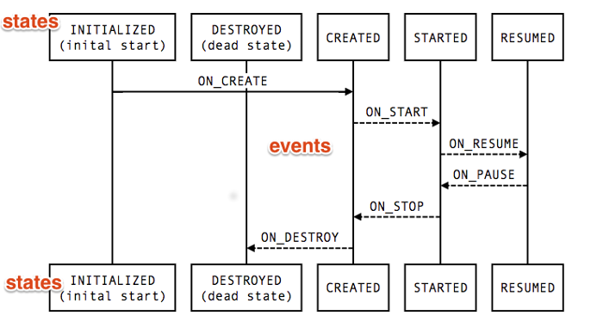
Architecture - Lifecycles
Manage your activity and fragment lifecycles
Notes:
Event
The lifecycle events that are dispatched from the framework and the Lifecycle class. These events map to the callback events in activities and fragments.
State
The current state of the component tracked by the Lifecycle object.

Slide 34
Architecture - Lifecycles
Manage your activity and fragment lifecycles
public class MyObserver implements LifecycleObserver {
@OnLifecycleEvent(Lifecycle.Event.ON_RESUME)
public void connectListener() {
...
}
@OnLifecycleEvent(Lifecycle.Event.ON_PAUSE)
public void disconnectListener() {
...
}
}
myLifecycleOwner.getLifecycle().addObserver(new MyObserver());

Slide 35
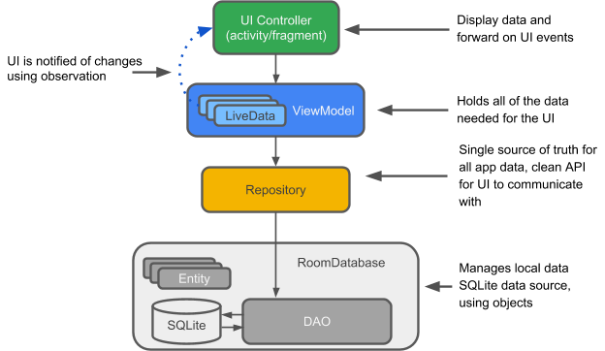

Architecture - Room
Fluent SQLite database access
Notes:
Entity: When working with Room, this is an annotated class that describes a database table.
SQLite database: On the device, data is stored in an SQLite database. The Room persistence library creates and maintains this database for you.
DAO: Data access object. A mapping of SQL queries to functions. When you use a DAO, you call the methods, and Room takes care of the rest.
Room database: Database layer on top of SQLite database that takes care of mundane tasks that you used to handle with an SQLiteOpenHelper. Database holder that serves as an access point to the underlying SQLite database. The Room database uses the DAO to issue queries to the SQLite database.
Repository: A class that you create. You use the Repository for managing multiple data sources.
ViewModel: Provides data to the UI. Acts as a communication center between the Repository and the UI. Hides where the data originates from the UI. ViewModel instances survive Activity/Fragment recreation.
LiveData: A data holder class that can be observed. Always holds/caches latest version of data. Notifies its observers when the data has changed. LiveData is lifecycle aware. UI components just observe relevant data and don't stop or resume observation. LiveData automatically manages all of this since it's aware of the relevant lifecycle status changes while observing.

Slide 36
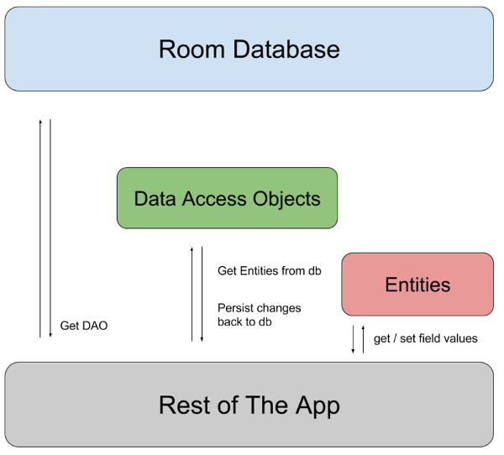
Architecture - Room
Entity
@Entity
public class User {
@PrimaryKey
public int uid;
@ColumnInfo(name = "first_name")
public String firstName;
@ColumnInfo(name = "last_name")
public String lastName;
}

Slide 37
Architecture - Room
Dao
@Dao
public interface UserDao {
@Query("SELECT * FROM user")
List<User> getAll();
@Query("SELECT * FROM user WHERE uid IN (:userIds)")
List<User> loadAllByIds(int[] userIds);
@Query("SELECT * FROM user WHERE first_name LIKE :first AND " + "last_name LIKE :last LIMIT 1")
User findByName(String first, String last);
@Insert
void insertAll(User... users);
@Delete
void delete(User user);
}

Slide 38
Architecture - Room
Database
@Database(entities = {User.class}, version = 1)
public abstract class AppDatabase extends RoomDatabase {
public abstract UserDao userDao();
}
Create Database
AppDatabase db = Room.databaseBuilder(getApplicationContext(),
AppDatabase.class, "database-name").build();

Slide 39
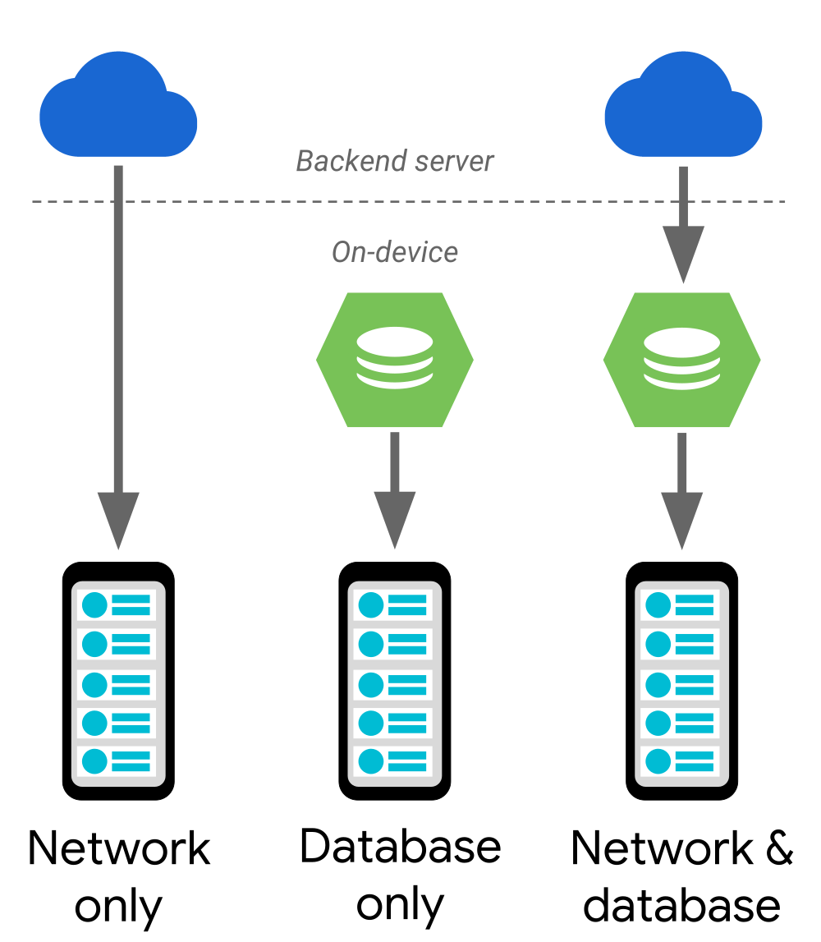

Architecture - Paging
Gradually load information on demand from your data source

Slide 40
Architecture - Paging
Gradually load information on demand from your data source
PagedList
public class ConcertViewModel extends ViewModel {
private ConcertDao concertDao;
public final LiveData<PagedList<Concert>> concertList;
// Creates a PagedList object with 50 items per page.
public ConcertViewModel(ConcertDao concertDao) {
this.concertDao = concertDao;
concertList = new LivePagedListBuilder<>(
concertDao.concertsByDate(), 50).build();
}
}

Slide 41
Architecture - Paging
Gradually load information on demand from your data source
Data
@Dao
public interface ConcertDao {
// The Integer type parameter tells Room to use a
// PositionalDataSource object.
@Query("SELECT * FROM concerts ORDER BY date DESC")
DataSource.Factory<Integer, Concert> concertsByDate();
}

Slide 42
Architecture - Paging
Gradually load information on demand from your data source
UI
public class BookmarkPagedAdapter extends PagedListAdapter<DataModel, ViewHolder> {
...
}

Slide 43
Architecture - Navigation
Handle everything needed for in-app navigation
Handling Fragment transactions
Handling Up and Back actions correctly by default
Providing standardized resources for animations and transitions
Treating deep linking as a first-class operation
Including Navigation UI patterns, such as navigation drawers and bottom navigation, with minimal additional work
Providing type safety when passing information while navigating
Visualizing and editing navigation graphs with Android Studio's Navigation Editor
If you want to use the Navigation Architecture Component with Android Studio, you must use Android Studio 3.2 Canary 14 or higher.

Slide 44
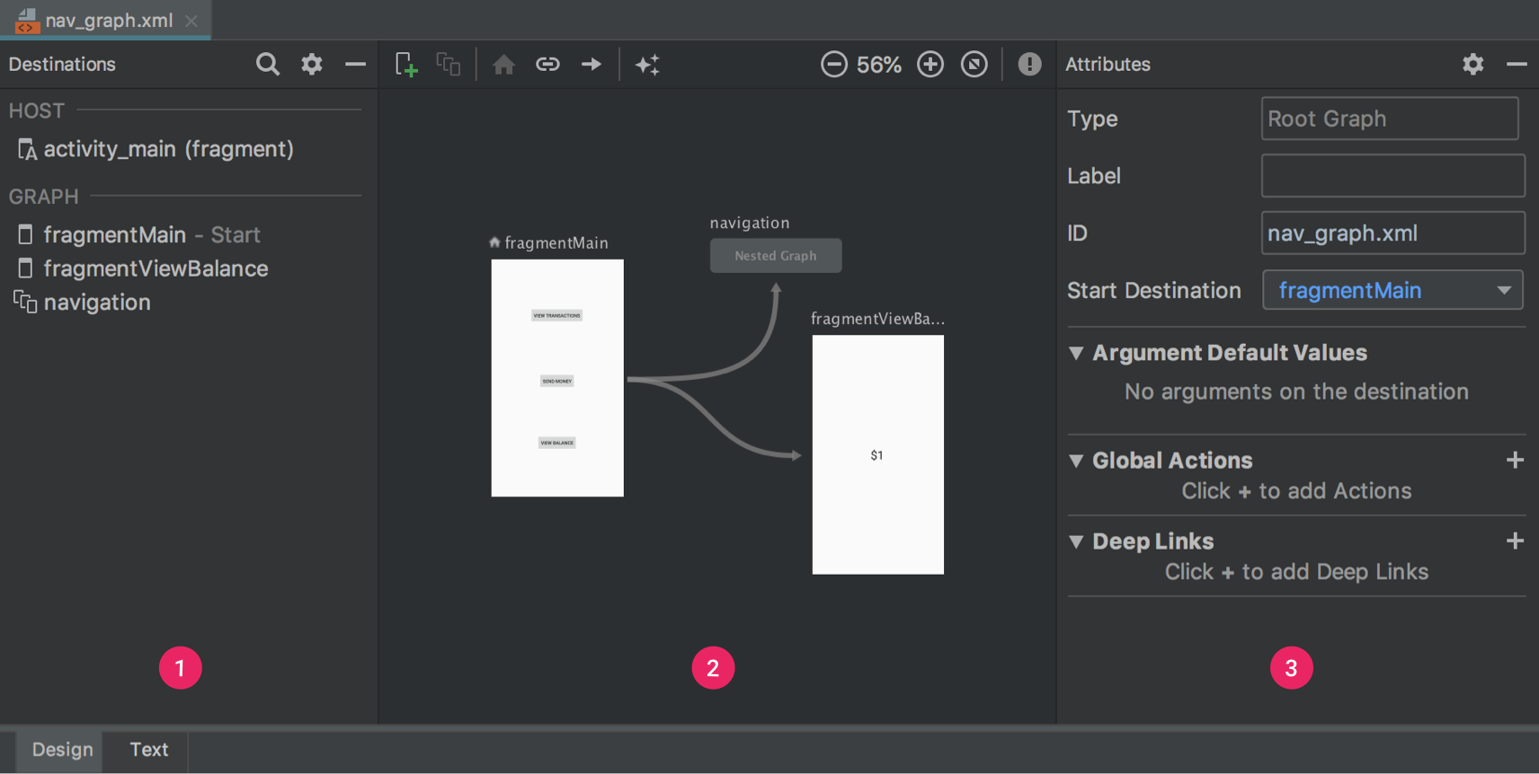
Architecture - Navigation
Handle everything needed for in-app navigation

Slide 45
Architecture - WorkManager
Manage your Android background jobs
Key features:
Backwards compatible up to API 14
Uses JobScheduler on devices with API 23+
Uses a combination of BroadcastReceiver + AlarmManager on devices with API 14-22
Add work constraints like network availability or charging status
Schedule asynchronous one-off or periodic tasks
Monitor and manage scheduled tasks
Chain tasks together
Guarantees task execution, even if the app or device restarts

Slide 46
Architecture - WorkManager
Manage your Android background jobs
public class UploadWorker extends Worker {
public UploadWorker(@NonNull Context context, @NonNull WorkerParameters params) {
super(context, params);
}
@Override
public Result doWork() {
// Do the work here--in this case, upload the images.
uploadImages()
// Indicate whether the task finished successfully with the Result
return Result.success()
}
}

Slide 47
Architecture - WorkManager
Manage your Android background jobs
OneTimeWorkRequest
OneTimeWorkRequest uploadWorkRequest = new OneTimeWorkRequest.Builder(UploadWorker.class).build()
PeriodicWorkRequest
Constraints constraints = new Constraints.Builder().setRequiresCharging(true).build();
PeriodicWorkRequest saveRequest = new PeriodicWorkRequest.Builder(SaveImageFileWorker.class, 1, TimeUnit.HOURS).setConstraints(constraints).build();
WorkManager.getInstance().enqueue(saveRequest);

Slide 48
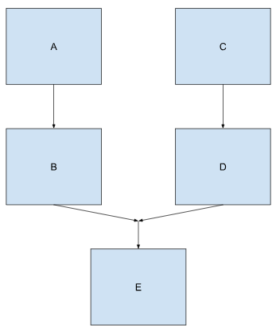
Architecture - WorkManager
Manage your Android background jobs
WorkContinuation chain1 = WorkManager.getInstance()
.beginWith(workA)
.then(workB);
WorkContinuation chain2 = WorkManager.getInstance()
.beginWith(workC)
.then(workD);
WorkContinuation chain3 = WorkContinuation
.combine(Arrays.asList(chain1, chain2))
.then(workE);
chain3.enqueue();

Slide 49
Android Jetpack Components
Behavior
Notes:
Foundation components provide cross-cutting functionality like backwards compatibility, testing and Kotlin language support.
Architecture components help you design robust, testable and maintainable apps.
Behavior components help your app integrate with standard Android services like notifications, permissions, sharing and the Assistant.
UI components provide widgets and helpers to make your app not only easy, but delightful to use.

Slide 50

Behavior - CameraX
Easily add camera capabilities to your apps
Ease of use
Preview: get an image on the display
Image analysis: access a buffer seamlessly for use in your algorithms, such as to pass into MLKit
Image capture: save high-quality images
Consistency across devices
New camera experiences

Slide 51

Behavior - Download Manager
Schedule and manage large downloads
class DownloadManager.Query
This class may be used to filter download manager queries.
class DownloadManager.Request
This class contains all the information necessary to request a new download.

Slide 52
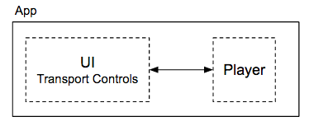
Behavior - Media & Playback
Backwards compatible APIs for media playback and routing (including Google Cast)
A multimedia application that plays audio or video usually has two parts:
A player that takes digital media in and renders it as video and/or audio.
A UI with transport controls to run the player and optionally display the player's state.

Slide 53
Behavior - Media & Playback
Backwards compatible APIs for media playback and routing (including Google Cast)
A multimedia application that plays audio or video usually has two parts:
A player that takes digital media in and renders it as video and/or audio.
A UI with transport controls to run the player and optionally display the player's state.

Slide 54
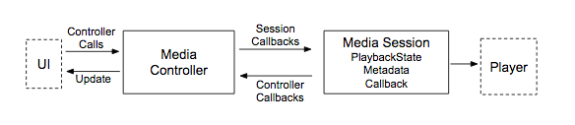
Behavior - Media & Playback
Backwards compatible APIs for media playback and routing (including Google Cast)

Slide 55
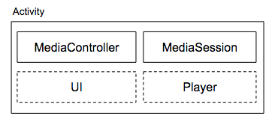
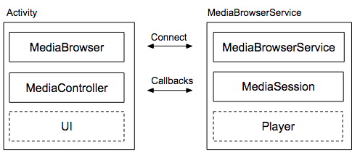
Behavior - Media & Playback
Video apps versus audio apps

Slide 56
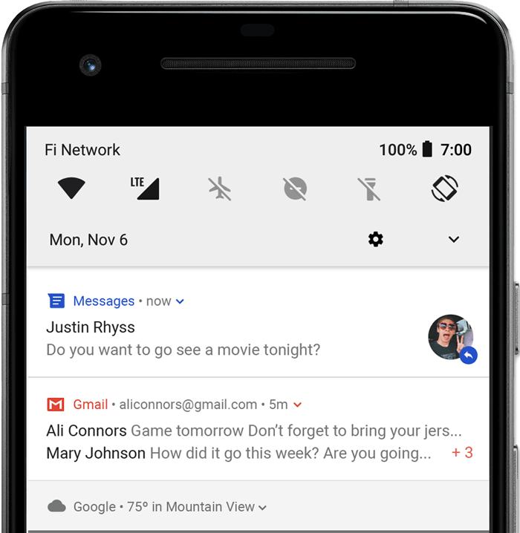
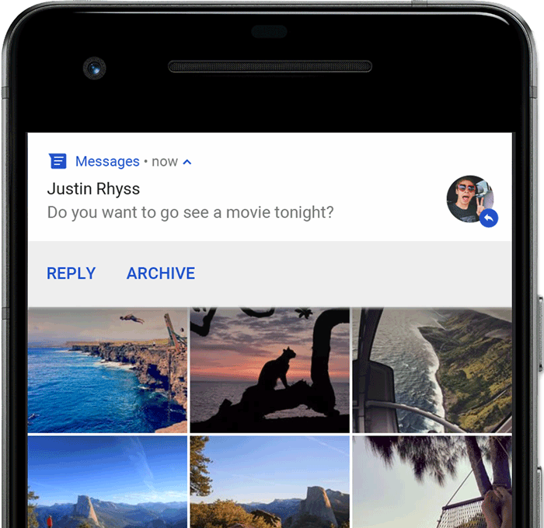
Behavior - Notifications
Provides a backwards-compatible notification API with support for Wear and Auto
Status bar and notification drawer Heads-up notification

Slide 57
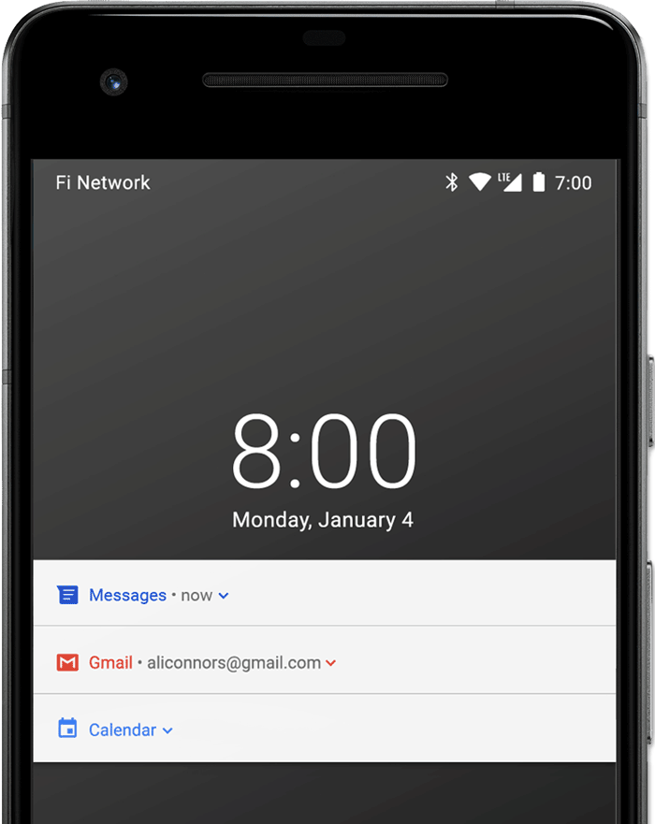
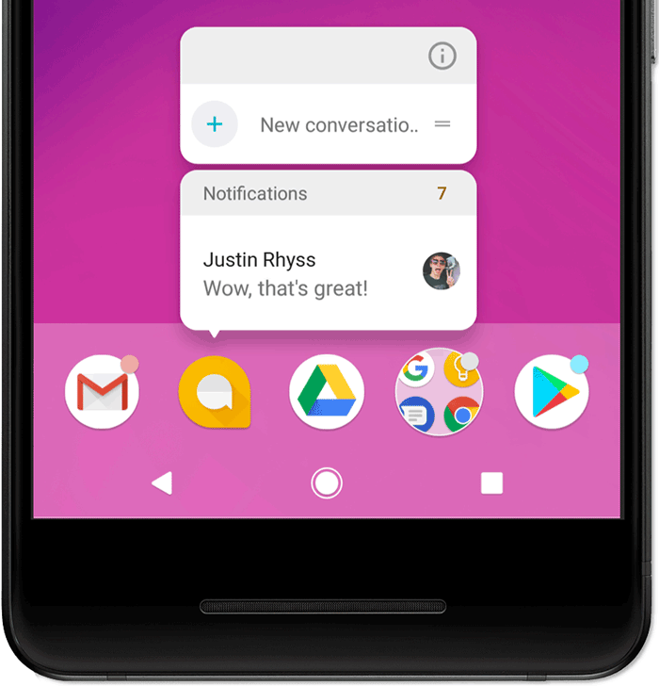
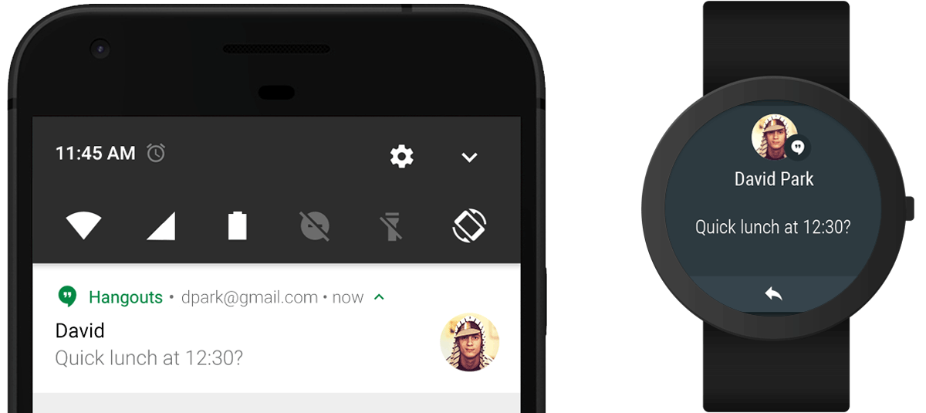
Behavior - Notifications
Provides a backwards-compatible notification API with support for Wear and Auto
Lock screen App icon badge Wear OS devices

Slide 58
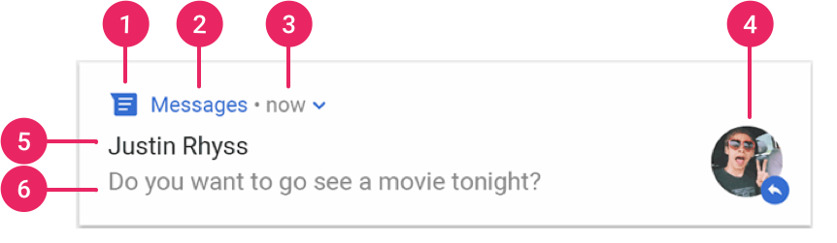
Behavior - Notifications
Provides a backwards-compatible notification API with support for Wear and Auto
Small icon: This is required and set with setSmallIcon().
App name: This is provided by the system.
Time stamp: This is provided by the system but you can override with setWhen() or hide it with setShowWhen(false).
Large icon: This is optional (usually used only for contact photos; do not use it for your app icon) and set withsetLargeIcon().
Title: This is optional and set with setContentTitle().
Text: This is optional and set with setContentText().

Slide 59
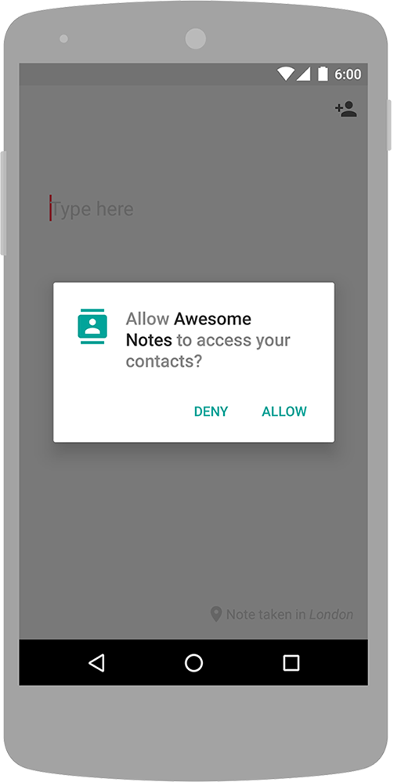
Behavior - Permissions
Compatibility APIs for checking and requesting app permissions
<manifest xmlns:android="http://schemas.android.com/apk/res/android"
package="com.example.snazzyapp">
<uses-permission android:name="android.permission.SEND_SMS"/>
<application ...>
...
</application>
</manifest>

Slide 60
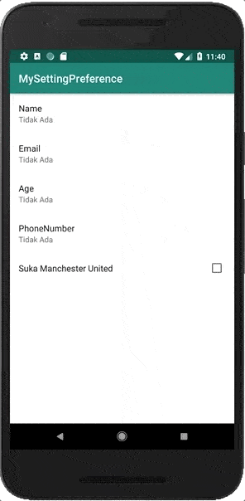
Behavior - Preferences
Create interactive settings screens
<androidx.preference.PreferenceScreen
xmlns:app="http://schemas.android.com/apk/res-auto">
<SwitchPreferenceCompat
app:key="notifications"
app:title="Enable message notifications"/>
<Preference
app:key="feedback"
app:title="Send feedback"
app:summary="Report technical issues or suggest new features"/>
</androidx.preference.PreferenceScreen>

Slide 61
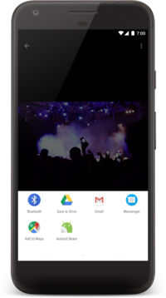
Behavior - Sharing
Provides a share action suitable for an app’s action bar
<menu xmlns:android="http://schemas.android.com/apk/res/android">
<item
android:id="@+id/menu_item_share"
android:showAsAction="ifRoom"
android:title="Share"
android:actionProviderClass=
"android.widget.ShareActionProvider" />
...
</menu>

Slide 62
private ShareActionProvider shareActionProvider;
...
@Override
public boolean onCreateOptionsMenu(Menu menu) {
// Inflate menu resource file.
getMenuInflater().inflate(R.menu.share_menu, menu);
// Locate MenuItem with ShareActionProvider
MenuItem item = menu.findItem(R.id.menu_item_share);
// Fetch and store ShareActionProvider
shareActionProvider = (ShareActionProvider) item.getActionProvider();
// Return true to display menu
return true;
}
// Call to update the share intent
private void setShareIntent(Intent shareIntent) {
if (shareActionProvider != null) {
shareActionProvider.setShareIntent(shareIntent);
}
}

Slide 63
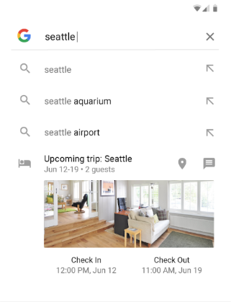
Behavior - Slices
Create flexible UI elements that can display app data outside the app
Android’s new approach to remote content :
Templated
Interactive
Updatable
Backwards-compatible
dependencies {
// ...
implementation "androidx.slice:slice-builders:(latest version)"
// ...
}

Slide 64
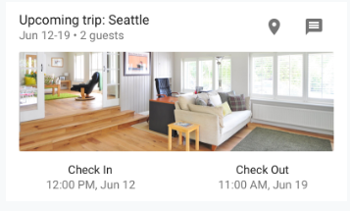
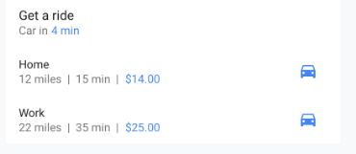
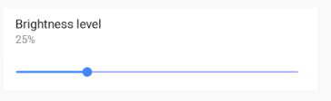
Behavior - Slices
Templated
Dynamic and interactive content Enables rich and flexible layout

Slide 65
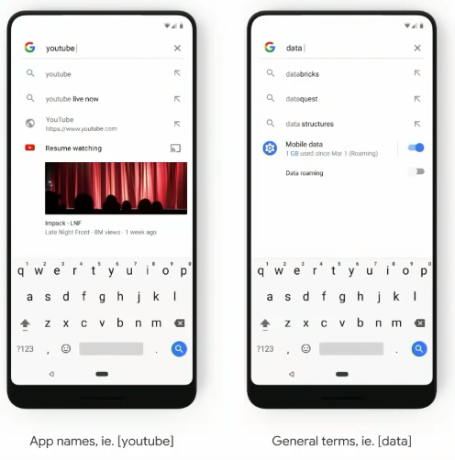
Behavior - Slices
Launching in search
Enhance predictions with rich app content
Accelerate navigation, task completion and discovery of app content.
App names
eg. [maps], [lyft], [airbnb]
General trems
eg. [get a ride], [trending videos]

Slide 66
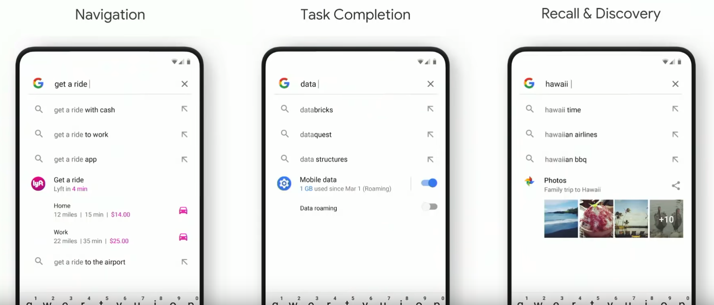
Behavior - Slices
Example Use Case

Slide 67
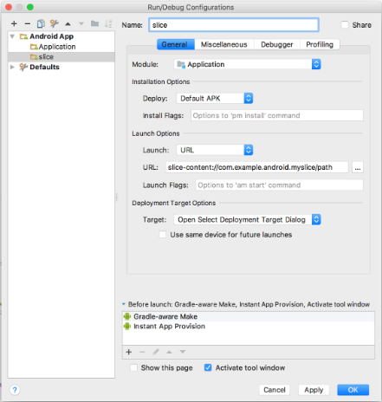
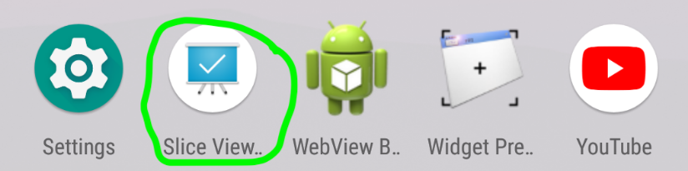
Behavior - Slices
Example Use Case
adb install -r -t slice-viewer.apk
Enter slice-<your slice URI> in the URL field
Example: slice-content://com.example.your.sliceuri

Slide 68
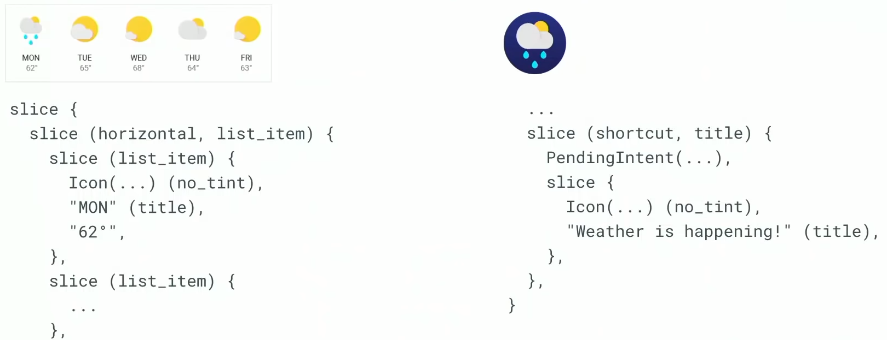
Behavior - Slices
Slice Structure

Slide 69
Android Jetpack Components
UI
Notes:
Foundation components provide cross-cutting functionality like backwards compatibility, testing and Kotlin language support.
Architecture components help you design robust, testable and maintainable apps.
Behavior components help your app integrate with standard Android services like notifications, permissions, sharing and the Assistant.
UI components provide widgets and helpers to make your app not only easy, but delightful to use.

Slide 70

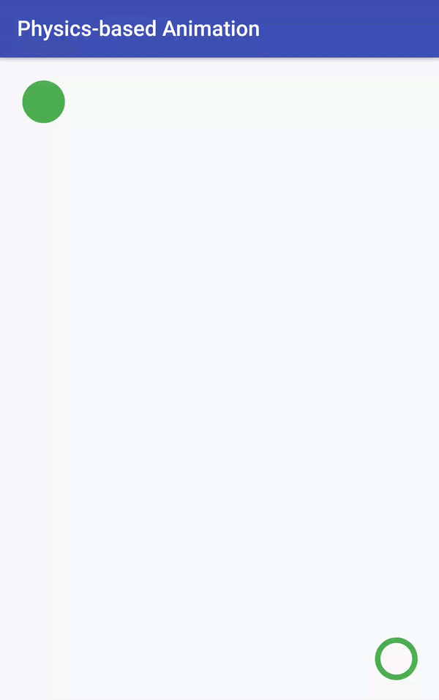

UI - Animations & Transitions
Move widgets and transition between screens

Slide 71
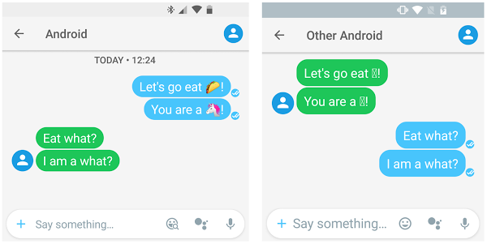

UI - Emoji
Enable an up-to-date emoji font on older platforms

Slide 72
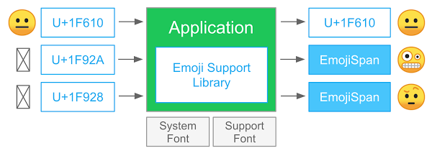
UI - Emoji
How does EmojiCompat work?
dependencies {
...
implementation "androidx.emoji:emoji:1.0.0"
}

Slide 73
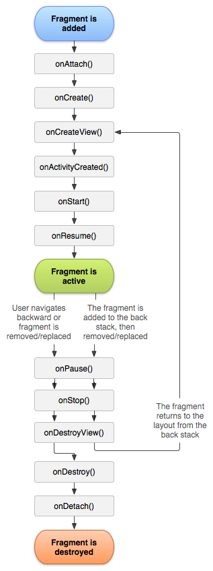

UI - Fragment
A basic unit of composable UI

Slide 74

UI - Layout
Lay out widgets using different algorithms
<?xml version="1.0" encoding="utf-8"?>
<LinearLayout xmlns:android="http://schemas.android.com/apk/res/android"
android:layout_width="match_parent"
android:layout_height="match_parent"
android:orientation="vertical" >
<TextView android:id="@+id/text"
android:layout_width="wrap_content"
android:layout_height="wrap_content"
android:text="Hello, I am a TextView" />
<Button android:id="@+id/button"
android:layout_width="wrap_content"
android:layout_height="wrap_content"
android:text="Hello, I am a Button" />
</LinearLayout>

Slide 75

UI - Palette
Pull useful information out of color palettes
dependencies {
...
implementation 'androidx.palette:palette:1.0.0'
}

Slide 76


What’s Next?

Slide 77
Study guide: Associate Android Developer Certification
Android core
User interface
Data management
Debugging
Testing

Slide 78
Android Core
To prepare for the AAD certification exam, Android developers should:
Understand the architecture of the Android system (MADE)
Be able to describe the basic building blocks of an Android app (MADE)
Know how to build and run an Android app (MADE)
Display simple messages in a popup using a Toast or a Snackbar (MADE)
Be able to display a message outside your app's UI using Notifications (MADE)
Understand how to localize an app (MADE)
Be able to schedule a background task using JobScheduler (MADE)

Slide 79
User Interface
To prepare for the AAD certification exam, Android developers should:
Understand the Android activity lifecycle (MADE)
Be able to create an Activity that displays a Layout (MADE)
Be able to construct a UI with ConstraintLayout (MADE)
Understand how to create a custom View class and add it to a Layout (MADE)
Know how to implement a custom app theme (MADE)
Be able to add accessibility hooks to a custom View (MADE)
Know how to apply content descriptions to views for accessibility (MADE)
Understand how to display items in a RecyclerView (MADE)
Be able to bind local data to a RecyclerView list using the Paging library (Android Jetpack Pro)
Know how to implement menu-based navigation (MADE)
Understand how to implement drawer navigation (MADE)

Slide 80
Data Management
To prepare for the AAD certification exam, Android developers should:
Understand how to define data using Room entities (Android Jetpack Pro)
Be able to access Room database with data access object (DAO) (Android Jetpack Pro)
Know how to observe and respond to changing data using LiveData (Android Jetpack Pro)
Understand how to use a Repository to mediate data operations (Android Jetpack Pro)
Be able to read and parse raw resources or asset files (MADE dan Android Jetpack Pro)
Be able to create persistent Preference data from user input (MADE)
Understand how to change the behavior of the app based on user preferences (MADE)

Slide 81
Debugging
To prepare for the AAD certification exam, Android developers should:
Understand the basic debugging techniques available in Android Studio (MADE dan Android Jetpack Pro)
Know how to debug and fix issues with an app's functional behavior and usability (MADE dan Android Jetpack Pro)
Be able to use the System Log to output debug information (MADE dan Android Jetpack Pro)
Understand how to use breakpoints in Android Studio (MADE dan Android Jetpack Pro)
Know how to inspect variables using Android Studio (MADE dan Android Jetpack Pro)

Slide 82
Testing
To prepare for the AAD certification exam, Android developers should:
Thoroughly understand the fundamentals of testing (MADE dan Android Jetpack Pro)
Be able to write useful local JUnit tests (MADE dan Android Jetpack Pro)
Understand the Espresso UI test framework (MADE dan Android Jetpack Pro)
Know how to write useful automated Android tests (MADE dan Android Jetpack Pro)

Slide 83





Slide 84




Thank you
Gilang Ramadhan
+6281904996393
gilang@dicoding.com

